Slide 1
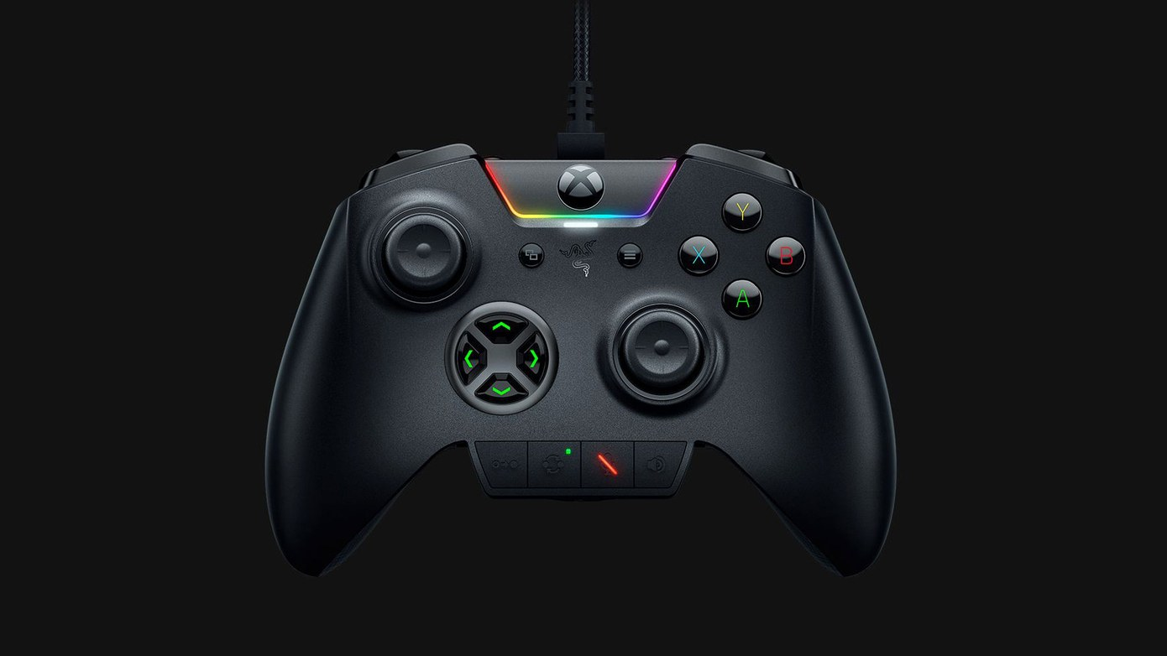

SHRI RAM COLLEGE
OF ENGINEERING & MANAGEMENT
Department of computer science
Presentation
on
Cloud Gaming
Made by: Kishan Kumar Rai

Slide 2
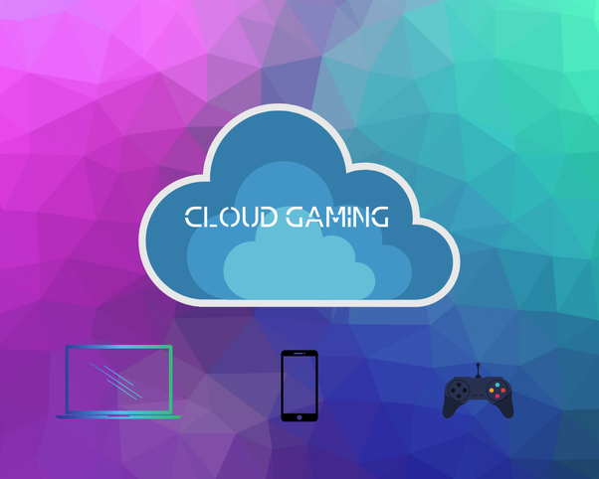
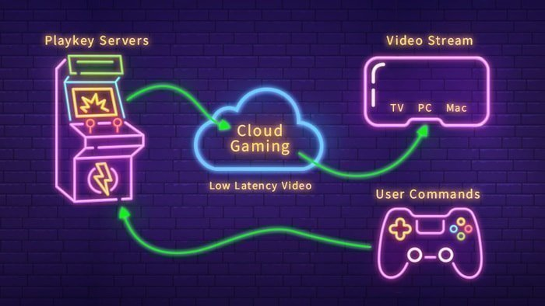
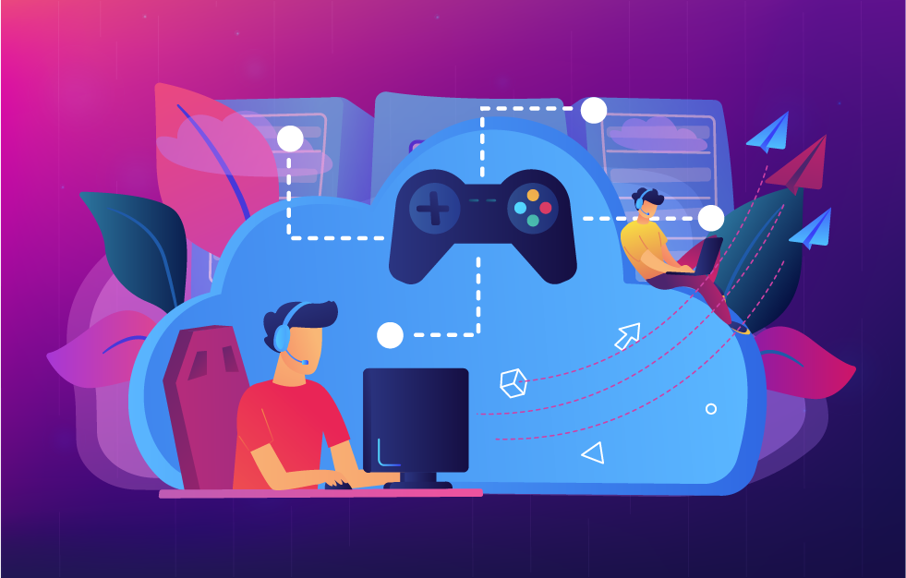
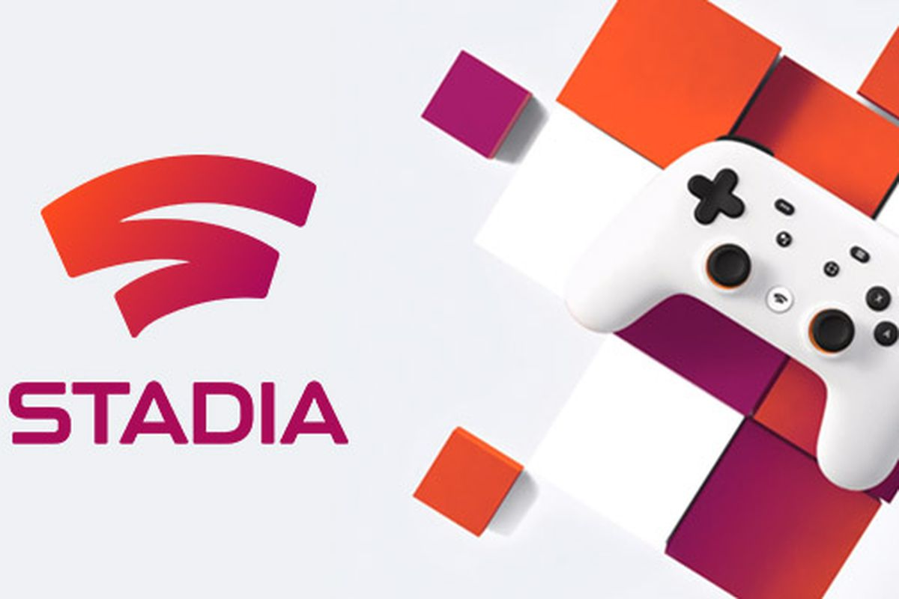

Slide 3

What is Cloud Gaming Exactly?
Cloud Gaming , sometimes called gaming on demand, is a type of online gaming that runs games on remote servers and streams them directly to a user’s device, or more colloquially, playing a game remotely from a cloud.

Slide 4


History
While connectivity is always improving, the idea of cloud gaming isn’t exactly new. It can be traced at least as far back as 2000 and G-cluster – a service that offered on-demand gaming via set-top boxes.
A variety of cloud gaming projects have come and gone since then, notably OnLive and Gaikai, which was acquired by Sony in 2012 to form the basis of PlayStation Now – Sony’s subscription service that lets players stream older titles on their console or PC.

Slide 5
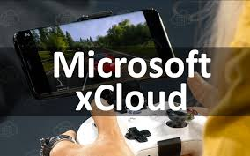

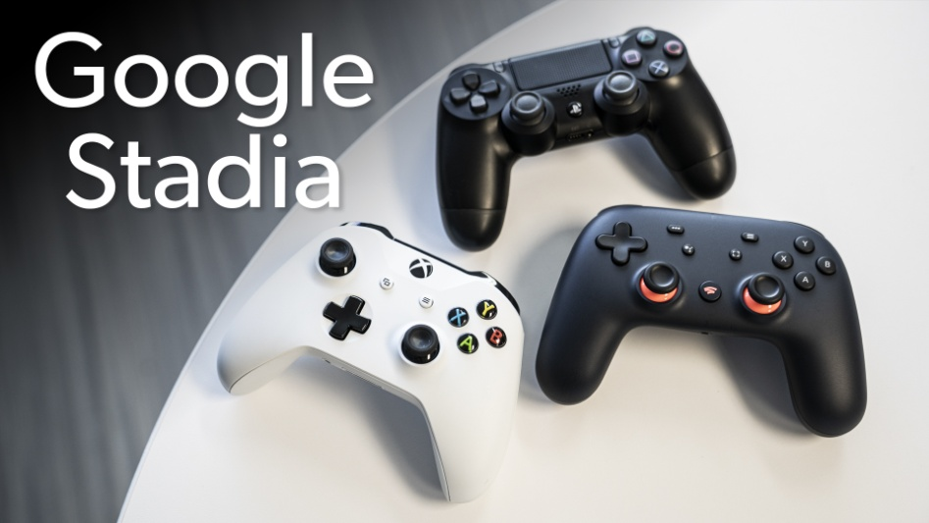
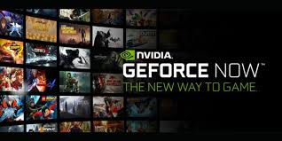


Slide 6
Present Technologies
Shadow – best overall gaming experience with low latency
GeForce Now
Vortex
Project xCloud
PlayStation Now

Slide 7
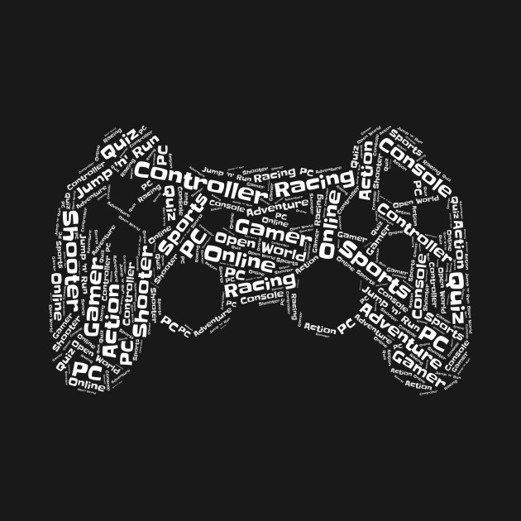
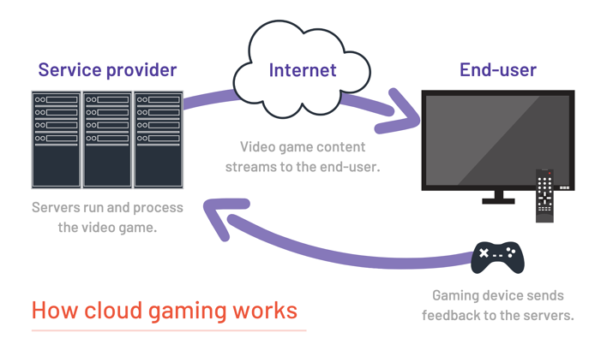
How it Works?

Slide 8
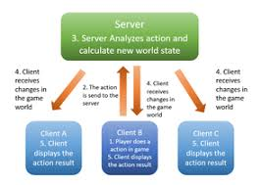
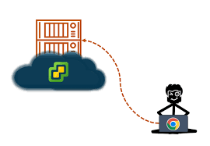
How it works
Cloud gaming is pretty simple if you understand how streaming platforms like Netflix work. When connecting to Netflix, you’re sending a request to a server that houses the content you want to stream.
You can do the same thing with gaming, you just have to do it many times over.

Slide 9



Advantages
Hardware limitations out of the window
Availability of more devices
No Piracy
Value of the gamer
More Competition

Slide 10


Disadvantages
Network Connection Dependency
Limited Features
Loss of Control
Technical Issues

Slide 11


Challenges
Managing cloud Spending
Lack of resource ,expertise
Managing multi cloud environments
Imature technology
Vendor lock-in

Slide 12
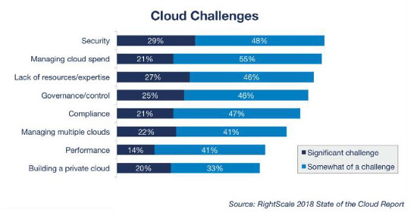

Slide 13

Conclusion
A game changing technology
Efficient cloud can be achieved with latest hardware & virtualization tech advancements.
Virtualization of GPU is greatly improved & is ready for gaming over public cloud
Only hardware encoders can achieve acceptable gaming performance
Cloud gaming is rapidly evolving particularly towards 4K UHD

Slide 14
Refrence
https://en.wikipedia.org/wiki/Cloud_gaming
https://www.cloudwards.net/top-five-cloud-services-for-gamers/
https://www.fasthosts.co.uk/blog/cloud/cloud-gaming-future
https://centretechnologies.com/5-cloud-computing-disadvantages/

Slide 15
THANK YOU

